Slide 1
Remotely Controlled Robot
Team 9
BHASKAR I. BANDYOPADHYAY
NILEKH M. CHAUDHARI
UDDHAV P. AROTE
College : Vidyavardhini’s College Of Engineering & Technology

Slide 2
Overview
Idea
Problem statement
Project scope
Requirements
Task specifications
Task distribution
Architecture and FSM of the robot program
Task completion
Test Cases
Performance metrics
Reusability features
Future enhancement
Advantages and limitations

Slide 3
Idea
Zigbee Associated Network based Dynamic Updation
To provide a standard web-interface to the SPARK-V robot for remotely operating it.
Determining the exact position of the robot located at remote site.

Slide 4
Problem Statement
Controlling the robots over the Internet
Tracking the robot movements
Showing sensor values and battery level
Replicating the behavior of Gmail chat

Slide 5
Scope of Project
The scope of the project is wide and depends on the application context.
Eg: In Indusrties, it can be used to provide automation or delegation of manual labour.
Eg: In education sector, it can be used to aid distance learning.
Eg: In tele-surgery it can be used by doctors to remotely control operations.

Slide 6
Requirements - I
Hardware | Use in system
Spark V robot | The robot that will be controlled is Firebird V robot from Nex-robotics by the user.
Zigbee modules | The communication between sever computer and Firebird V robot will take place via 2 Zigbee modules, Maxstream XBee/ XBee Pro.
Server computer (with Xigbee module connected to its serial port) | The server computer with serial port is required to communicate with robot and the XBee module will be connected to its serial port using XBee adapter.
Client computer with RJ 45 port | Client computer with RJ 45 port is needed to communicate with the sever computer using TCP/IP protocol stack.

Slide 7
Requirements - II
Software | Use in system
Web browser with any OS | Any web browser like Mozilla Firefox, Opera on any OS platform is used to send requests to the Apache Server.
Apache server with GNU/Linux OS | Apache is a web server on which PHP scripts can be run.
GCC C compiler | To compile the C programs.
AVR Boot-loader software to burn code in Spark V microcontroller | The C program is burnt into the microcontroller using AVR Boot-loader .
MySQL database server | The database server keeps the information of the registered users and the bots.

Slide 8
Task Specifications
Easy to use UI
Dynamic registration of multiple robots
Controlling bots from remote location
Allows multiple clients(one-one operability)
Determining exact location of robot
Graphical representation
Processing of batch scripts
User can manipulate the IO port values
Data from the client will be sent in the packet format through XBee
Status of the robots will be communicated through XBee

Slide 9
Project Plan
Month | Task Accomplished
October 2011 | Idea, SRS, presentation, initial UI design
November 2011 | Collection of kit, code restructuring, study of HTML 5 canvas
December 2011 | Studied zigbee module and overview of robot architecture
January 2011 | PC-PC Zigbee communication in Linux, PC-Spark V communication, compiled & executed a C interpreter for linux(Pico C, Little C), send commands from interface
February 2011 | Sending and receiving daemons improved, displaying sensor values on the interface
March 2011 | Batch processing, setting port values, multiple bots
April 2011 | Documentation and refinement, optimization

Slide 10
Task Distribution
Team Member | Role Contribution
Bhaskar Bandyopadhyay | Event handling in the web application and AJAX calls, building the interpreter, batch processing, vector based mapping scheme, code integration
Uddhav Arote | Web interface design, Database handling (MySQL), Desinging the daemons, Integrating the PHP scripts, Code integration
Nilekh Chaudhari | HTML5 canvas design & implementation, Replicating the robot activities in canvas , Testing , Documentation

Slide 11
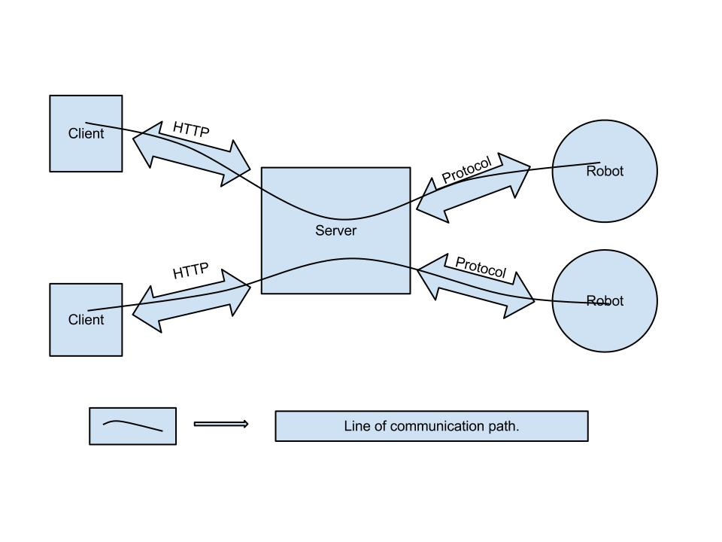
Architecture (Block Diagram)
Zigbee Associated Network based Dynamic Updation

Slide 12
Architecture
Zigbee Associated Network based Dynamic Updation
Multiple clients.
Multiple robots.
One robot can be controlled by one client (one to one operability).
Standard HTTP protocol for client communication.

Slide 13
Features
Zigbee Associated Network based Dynamic Updation
Graphical representation of the robots.
- HTML-5 canvas representation.
Robot Registration
- Dynamic registration of robot using specific robot ID.
Multiple Clients
- Standard web browser based clients for robot controlling.
Batch processing
- Printing data on the LCD.

Slide 14
FSM of Bot Program
Received command
Idle
Ready
Bot ID = received Bot ID
Executing
command
Bot ID <> received Bot ID
Finished execution

Slide 15
Task Completion
Communication between the robot and the computer
Challenge : The system is implemented in GNU/LINUX , and the drivers of the USB to serial converter were available for the Windows platform and communication was comparatively easy. How to make the communication happen in GNU/LINUX.
Solution : The chip used in USB adaptor is FTDI chip. And in GNU/LINUX there is direct support for the module. A small library for serial communication was used to make the communication happen between the computer and the robot.

Slide 16
Task Completion …. Contd
Implementing the interface daemons
Challenge : To build an interface which is dynamic and not include too many files in the web application.
Solution : AJAX is used to provide the dynamicity in the web application. The daemons are designed in such a way that they do not overload the system. Each division works asynchronously and is independent of each other except few.

Slide 17
Task Completion …. Contd
Canvas implementation
Challenge : The HTML5 canvas element is used to plot the position of the robot . Zooming and panning in the canvas.
Solution : The canvas element was carefully studied and various case studies of the canvas zoom and pan were studied .This helped in the implementation of Zoom and Pan in the canvas.

Slide 18
Test Cases
Test Case number | Test case name | Test case description
1 | Packet transmission via Zigbee Module | Sending and receiving the packets via the Zigbee module at the two ends of the communication line i.e. the server side and robot side modules communicate by sending and receiving the packets.
2 | Robot Registration | The robot registers to the system so that it can be used by the user at the client side. Here the robots send the packet to the server and the sever will register the robot to the system.
3 | User authentication | Before the client can use the system, the user at the client side will be authenticated by the system .If not authenticated the robot can be used by any person in the world.
4 | Simple robot movement | The keyboard keys will be used to control the motion of the robots, like W for up motion , A for left ,S for down and D for right, etc.

Slide 19
Test Cases ….. Contd
5 | Port I/O | The IO port pins of the robot can be set / reset from the system.
6 | Command interpreter | The interpreter will interpret the commands, mostly the syntax and semantics will be decided, example: UP 5 will be interpreted ‘move up for 5 seconds.
7 | Batch processing | A script will be given to the robot and it will execute it , eg : Printing the characters on the LCD.
8 | Multiple robot registration | Number of robots will register to the system so that they can be used by the users at the client side. It is same as test case 2,only difference is ,it is done for many robots.

Slide 20
Test Cases ….. Contd
9 | One client controlling multiple bots | A single user can control many robots together.It will be like , a user (say A) will control the motion of the robots .These robots won`t be controlled by the other users (say B,C,D,...) when the robot will be controlled by A.
10 | Multiple clients controlling multiple bots | Many users will control many robots, keeping in mind that M(users):1(robot) relationship won`t be allowed.

Slide 21
Performance Metrics
Keystrokes / sec.
Time between send daemon values & received values = processing + network delay.

Slide 22
Re-usability features
Interface is built using jQuery UI
Flexible API that can be easily extended
Simple communication protocol independent of underlying platform
Can use the interface independently

Slide 23
Future Enhancements
Implementing the concept mentioned above for all the different robotic platform available.
Enabling batch scripts support in different programming languages.
To support media streaming over the robot.
3D mapping of the arena.

Slide 24
Advantages
Zigbee Associated Network based Dynamic Updation
Over the internet
Onboard interpreter
Interfacing Custom hardware (managing port values)
Compatible with variant robotic platform

Slide 25
Limitations
Large number of bots
Data rate
No absolute positioning

Slide 26
Zigbee Associated Network based Dynamic Updation
Questions??

Slide 27

Zigbee Associated Network based Dynamic Updation

